Slide 1
Video Game Sales
Presented By: YAQEEN ALHAWAJ

Slide 2
OUTLINES
1
BACKSTORY
5
Algorithms
2
Questions
6
Results
3
Data
7
conclusion
4
Tools

Slide 3
1
BACKSTORY
A client contacted me to invest in the field of sales for electronic games to conduct an exploratory analysis of data in this field because he wants to know the sales rates in some countries and global sales and the type, the most famous of those electronic games, and he wants to know whether investing in this sector is rewarding or not.

Slide 4
Questions
1-Sales of different genre in North America?
2-In what year were the sales highest in Japan?
3-What is the most popular game name?
4- Finding out the oldest game in the dataset?
5-Sales of games in different platforms globally?
6-Finding out the game with maximum sales globally?
7-Finding out the game with minimum sales globally?
8-Global Sales over the years?

Slide 5



Data
WB
Kaggle
https://www.kaggle.com/gregorut/videogamesales
column 11
Here you could describe the detile if you need it
Data type:
String- Decimal -Integer
Rows 16600
Here you could describe the detile if you need it

Slide 6



Tools
Python
Pandas
Seaborn
Matplotlib
Jupyter notebook
Power point

Slide 7
Algorithms
01.
Data collection
02.
Explore data
03.
Finding and insights
04. Data cleaning

Slide 8
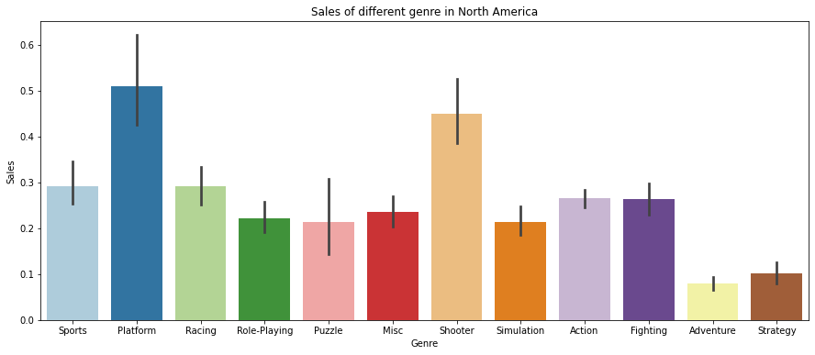
2
Results
Sales of different genre in North America?
In what year were the sales highest in Japan?
It was the best-selling year in Japan 1981
Finding out the game with maximum sales globally?

Slide 9
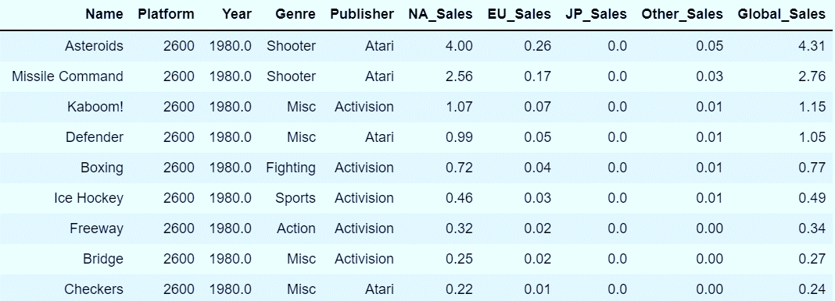
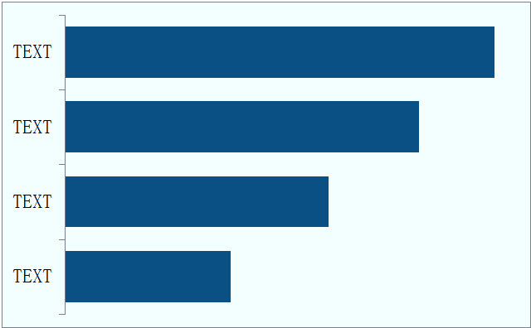
Results
What is the most popular games name?
Finding out the oldest game in the dataset?
Need for Speed: Most Wanted
LEGO Marvel Super Heroes
FIFA 14
Ratatouille
The oldest 1980

Slide 10
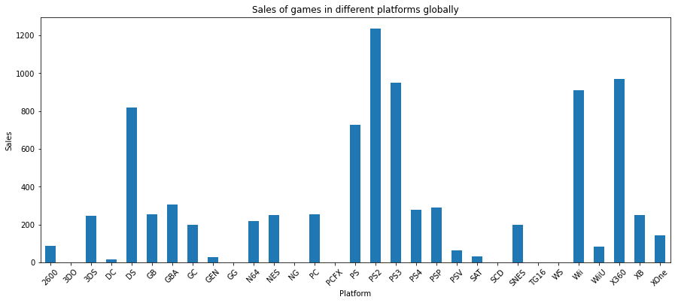
3
Results
Sales of games in different platforms globally?
PS2 has recorded highest sales globally

Slide 11
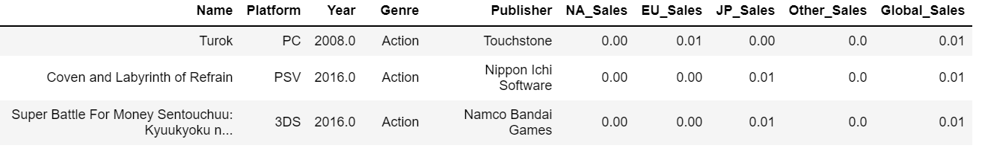
Results
Finding out the game with minimum sales globally?
the games with minimum

Slide 12
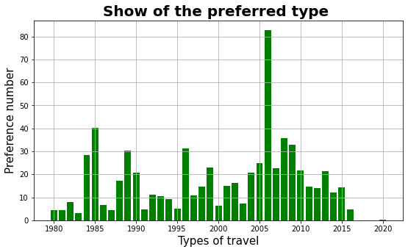
Results
Global Sales over the years?
Highest sales have been recorded from 2007 to 2010

Slide 13
conclusion
In conclusion, my bottom line will help my client choose whether or not to invest in the sales segment in gaming, based on the analysis of my exploratory data in a group

Slide 14
Thanks

